Slide 1


Welcome to our school!
‘Every child deserves the best possible start in life and the support that enables them to fulfill that potential.’ EYFS Framework 2021

Slide 2
Meet the Team
Miss Webley
Mrs Coyle
Mrs Ellis
Mr Hanlon
Gail McCully
Head teacher Assistant Head Teacher
Assistant Head Teacher
Assistant Head Teacher & SENDCO Pastoral
Sharon Murphy
Mrs Sweeney
Mrs Gallagher
Mrs Molyneux
Mrs Sefton
Mrs Blundell, Mrs Connolly and Mrs Dunne
Pastoral
Pastoral & attendance Learning Mentor
SENDCO
Early Years Lead Current Reception Teacher
Nursery Teacher, TA, and 2Y Room Practitioner

Slide 3
What is the Early Years Foundation Stage?
The Early Years Foundation Stage (E.Y.F.S.) is the stage of education for children from birth to the end of the Reception year.
It is based on the recognition that children learn best through play and active learning.

Slide 4
Areas of Learning
Within the E.Y.F.S there are seven Areas of learning.
Personal, Social & Emotional Development Communication and Language
Physical Development
Literacy Mathematics
Understanding of the World
Expressive Arts and Design

Slide 5
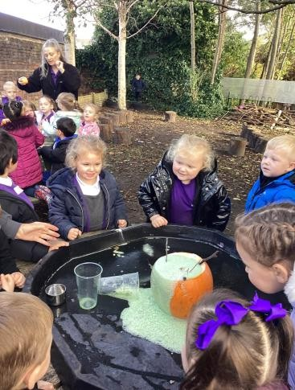
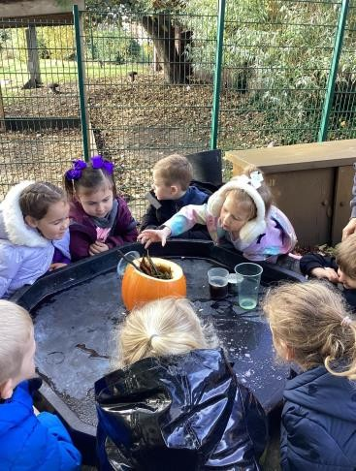
Forest School
Forest School is a big part of learning at Springwell.
We have a dedicated Forest School area which the children can access in all weathers.
It is a brilliant way for the children to learn about the natural world and is good for developing confidence resilience and for everyone’s well being.

Slide 6
Children’s Interests
We plan our topics based on the needs and interests of the children.
You are the expert on your child and we welcome your
input on your child’s interests and will incorporate these
into our planning.
We have forms we send home which ask for more information about your child. This helps us to ensure that we are able to plan to meet their individual learning needs.
This year, we did Superheroes, Princesses, fairy tales, dinosaurs and music!

Slide 7
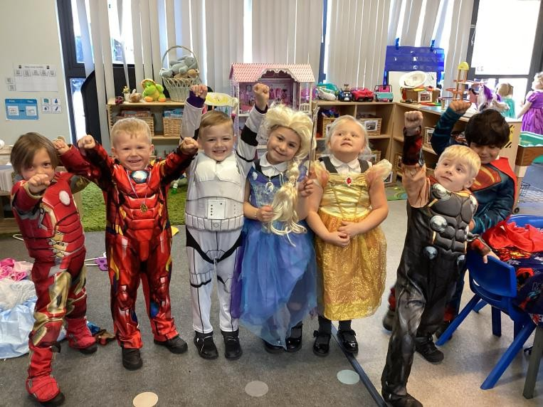
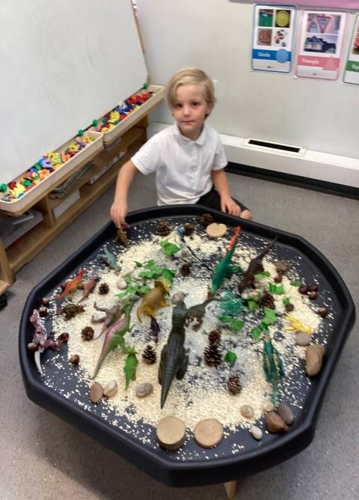
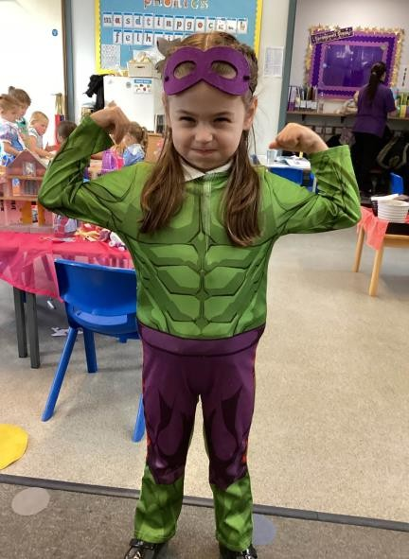
Children’s
Interests

Slide 8
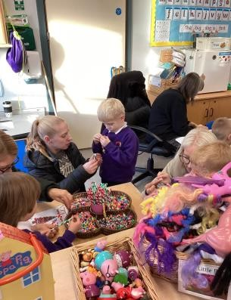
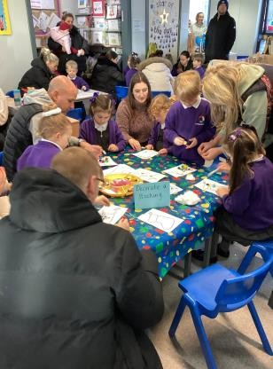
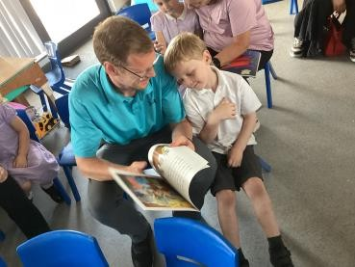
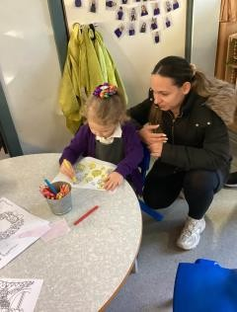
Parental Engagement
There are lots of opportunities to find out how you can support your child with their learning at home.
Early Reading Workshops
Come Read with Me
Phonics Workshops
Stay and Plays
Come and Read Sessions

Slide 9
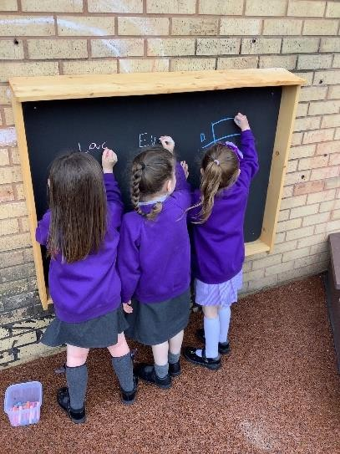
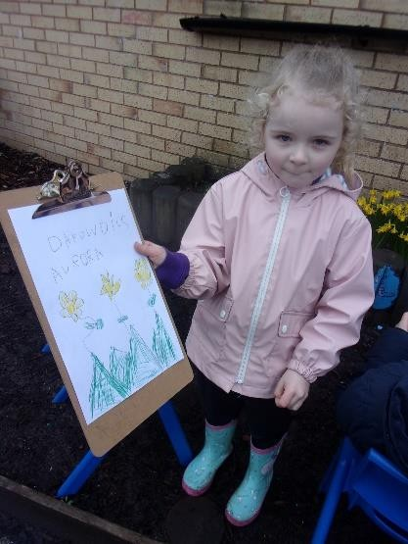
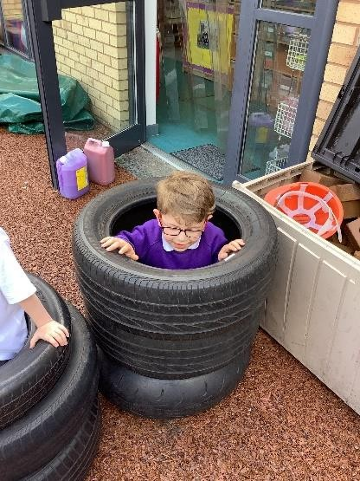
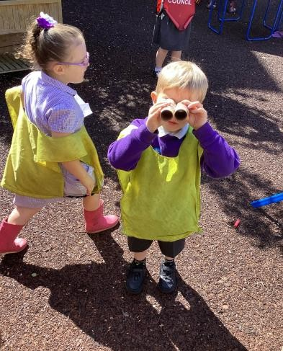
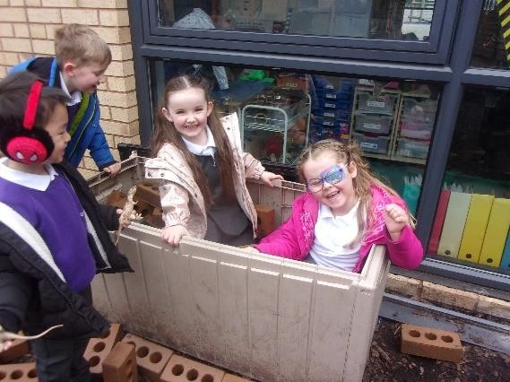
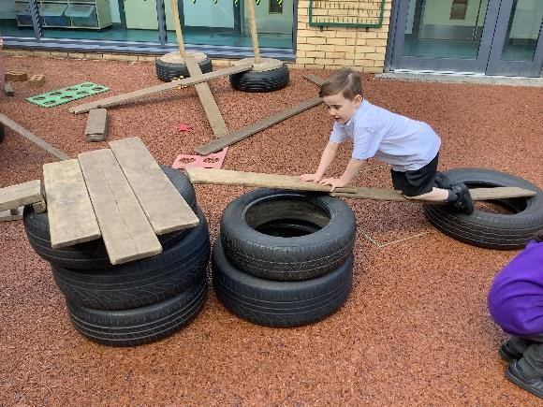
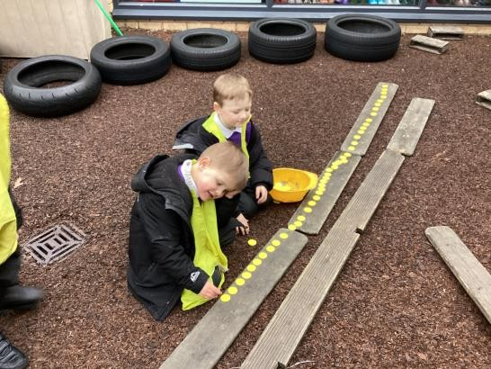
Outdoor Learning
We go out in ALL weathers, rain, sun and snow!

Slide 10
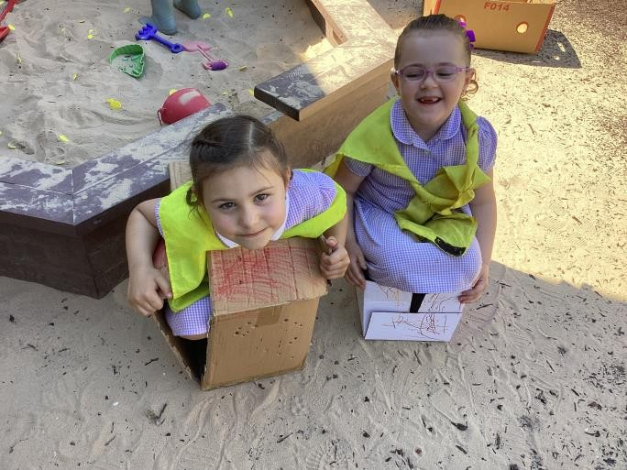
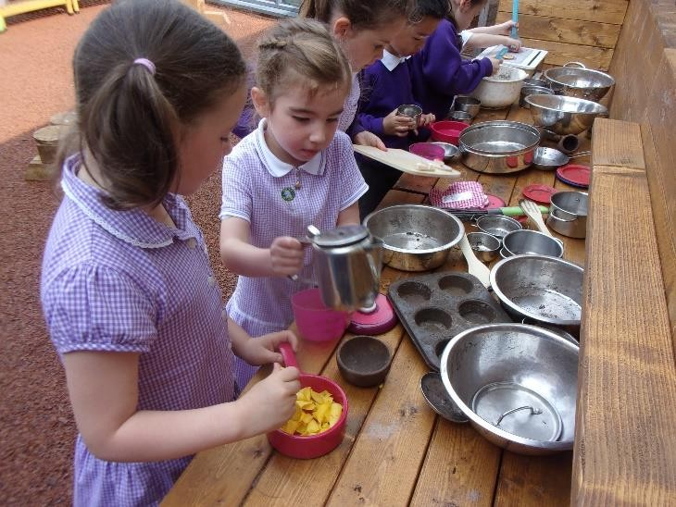
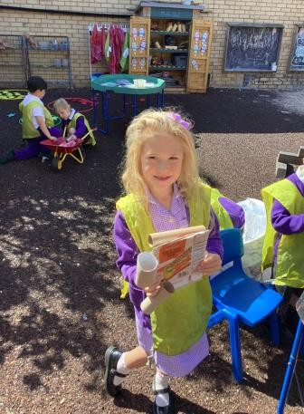
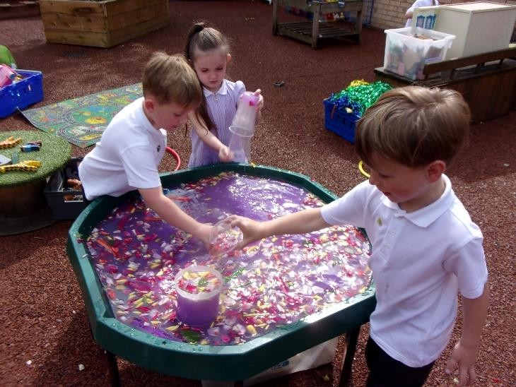

Slide 11
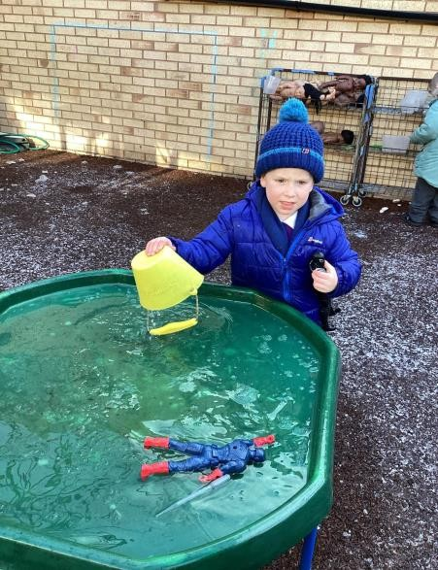
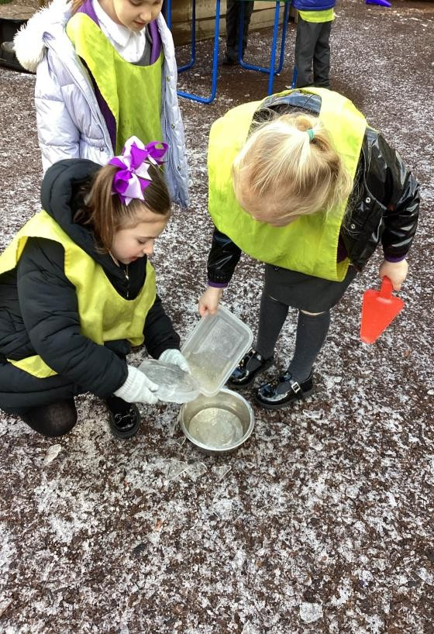
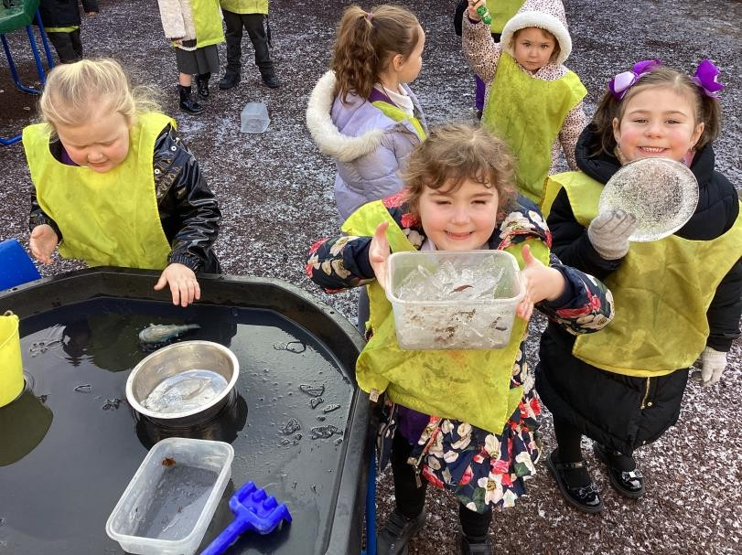

Slide 12
Uniform
School uniform is available from Paul’s Place in the Strand or Prima
Donna in Netherton.
Children can wear a school sweatshirt or cardigan and grey trousers, skirt or pinafore and a white polo shirt. Please label all of your child’s uniform and PE kit.
Please bring wellies to leave in school and label these too!
Please label everything, including shoes !
School water bottles are available from school at a cost of £2.00. However, children can use any water bottle for school, please label these too!
Your child will need a Springwell book bag, please purchase the smaller one with no strap on as these are for our younger children.

Slide 13
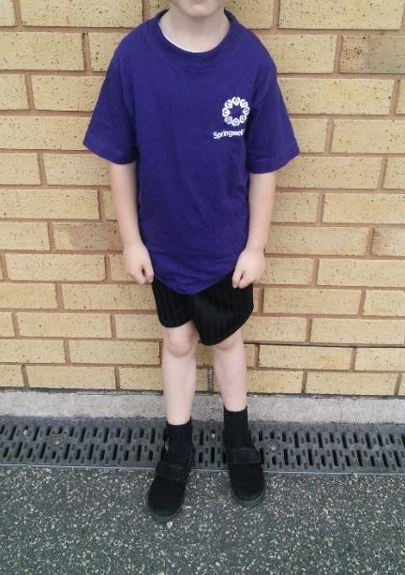
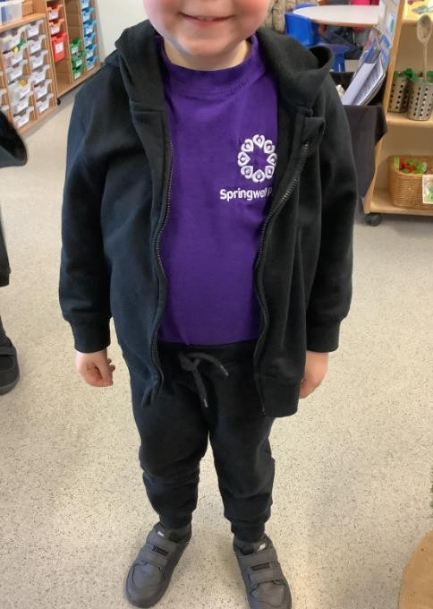
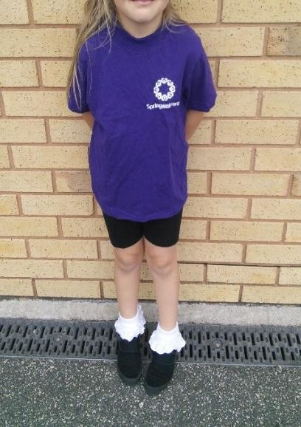
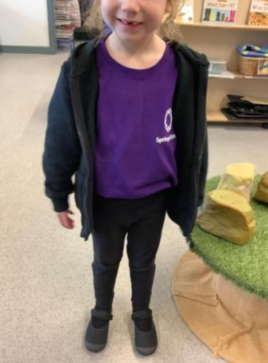
PE kit
We will have PE once a week. We will have a designated PE day. Your child will come to school wearing PE kit on this day for the full day.

Slide 14
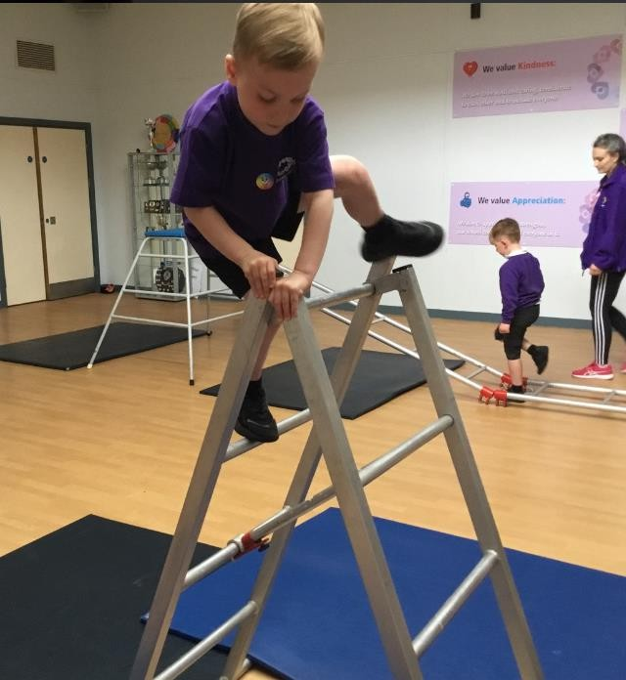
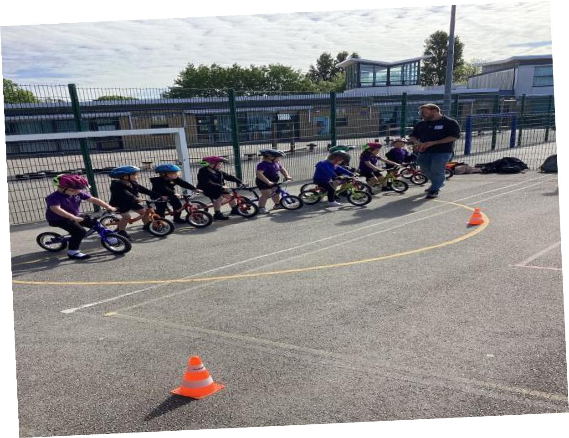
PE
Each term, we focus on a different skill in PE. This year, we have done-
Yoga
Balance Bikes
Multi-Skills
Large Apparatus
Ball Skills.

Slide 15
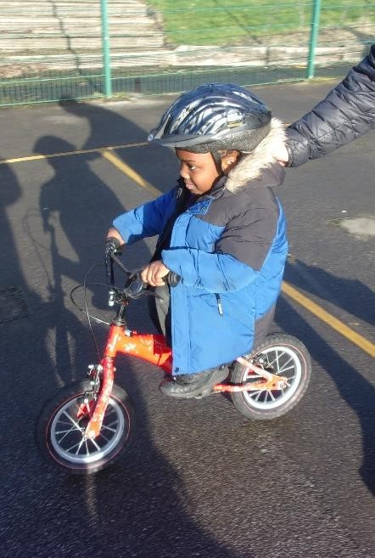
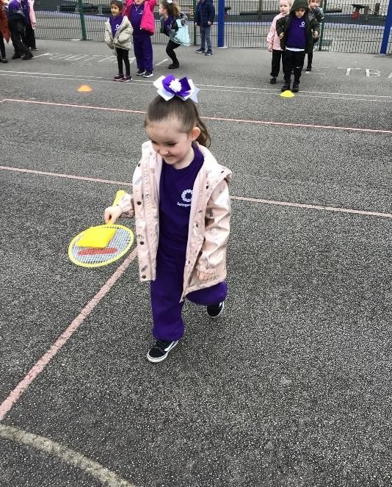
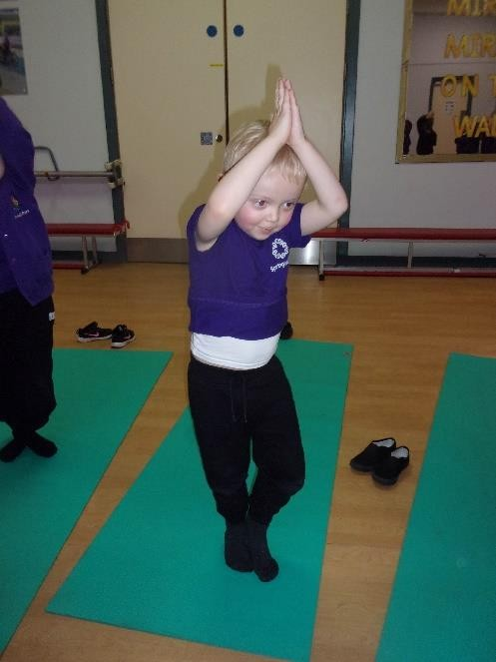
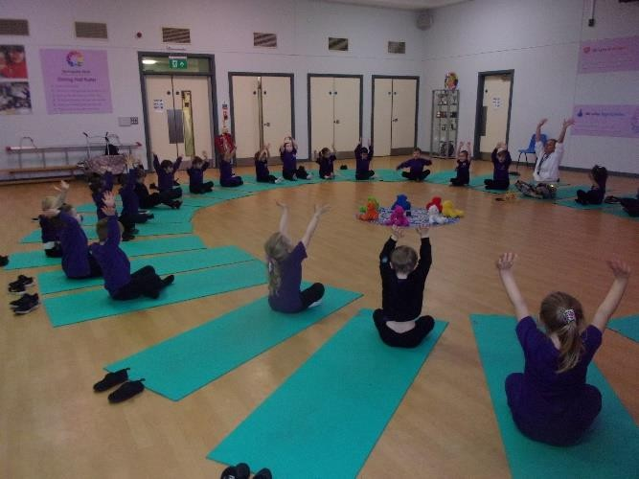
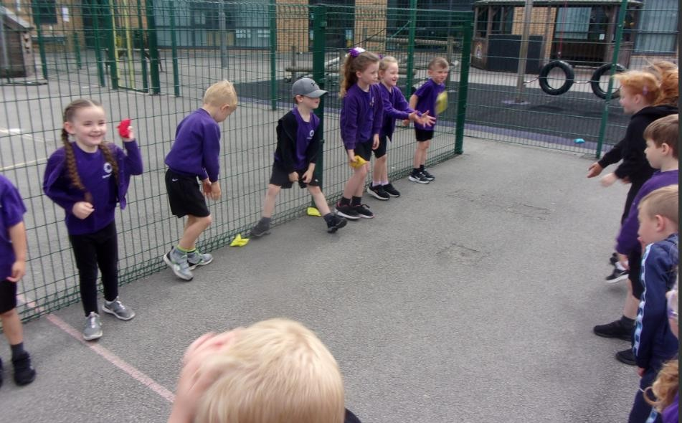
PE

Slide 16
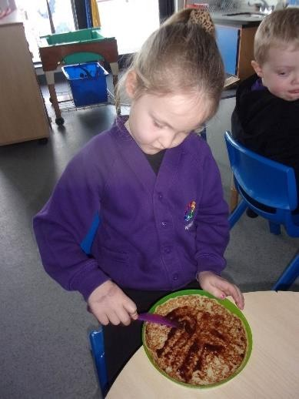
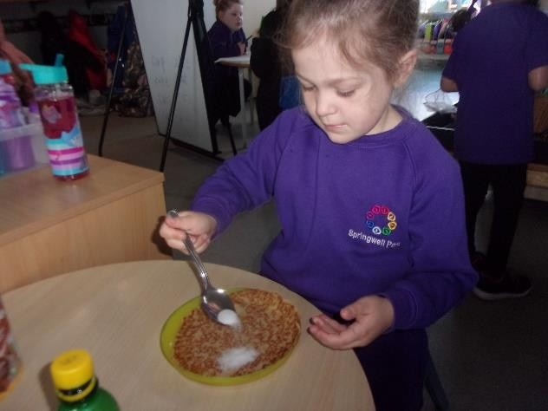
Snack
Children in Reception have snack every day, this is charged at £1 per week.
We ask that this is paid per half term, although you are welcome to pay for longer if your prefer.

Slide 17
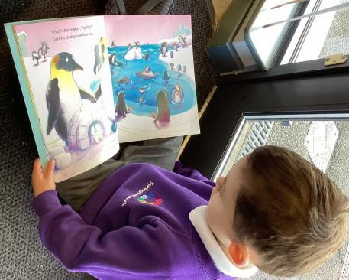
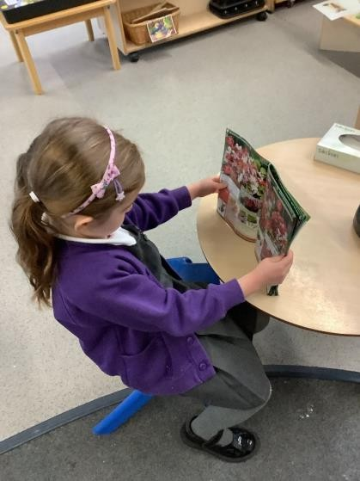
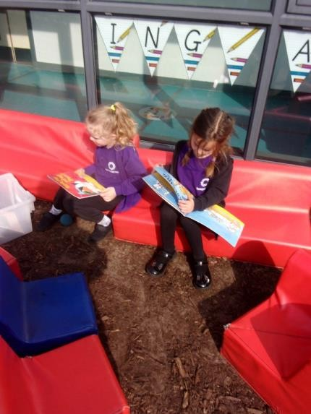
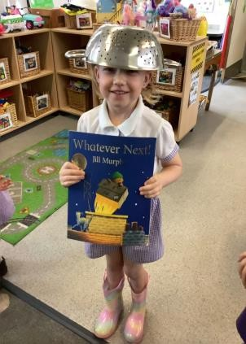
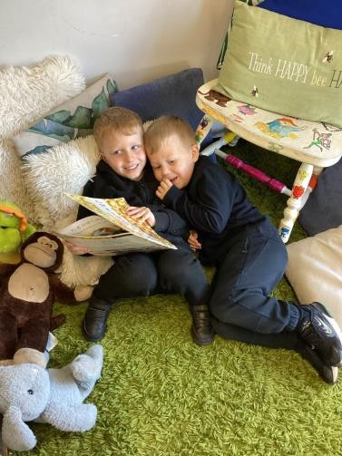
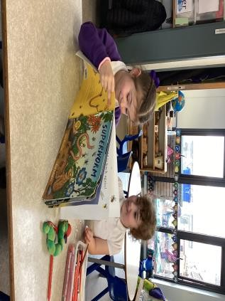
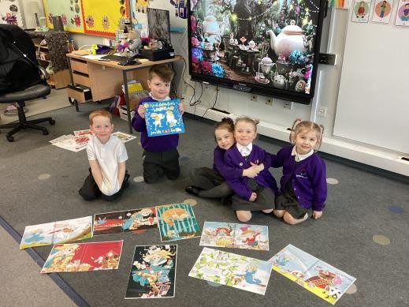
Sharing books
We love to encourage a love of reading!

Slide 18
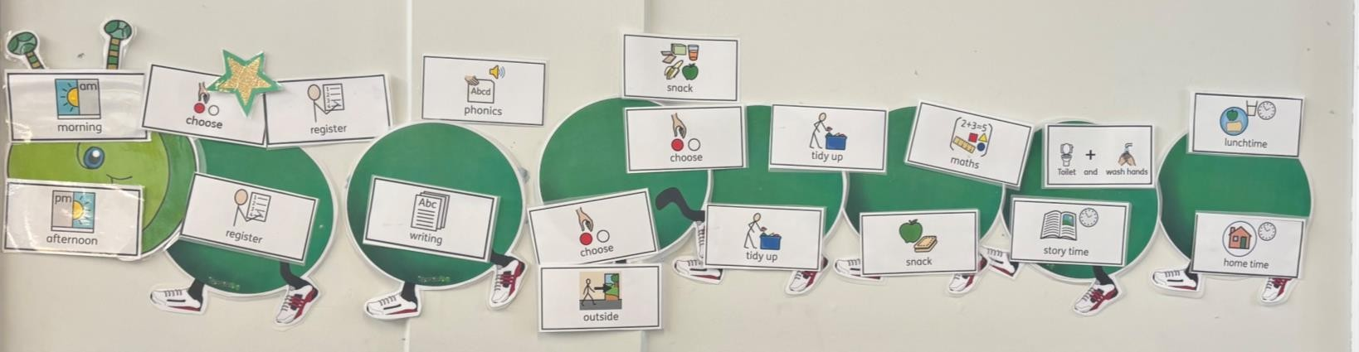
Structure of the Day
Classroom doors will be open from 8.40am
Children must be in school by 8.55am, the school gate will close at this time. Any late arrivals will need to enter school via the main office.
At the end of the day, children should be collected from the classroom doors at 3.10pm.

Slide 19
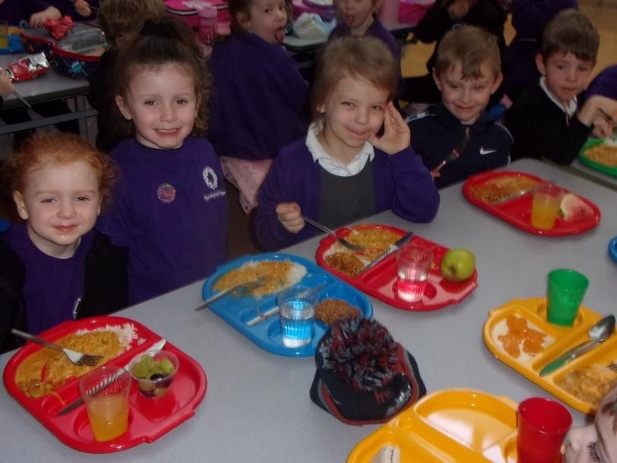
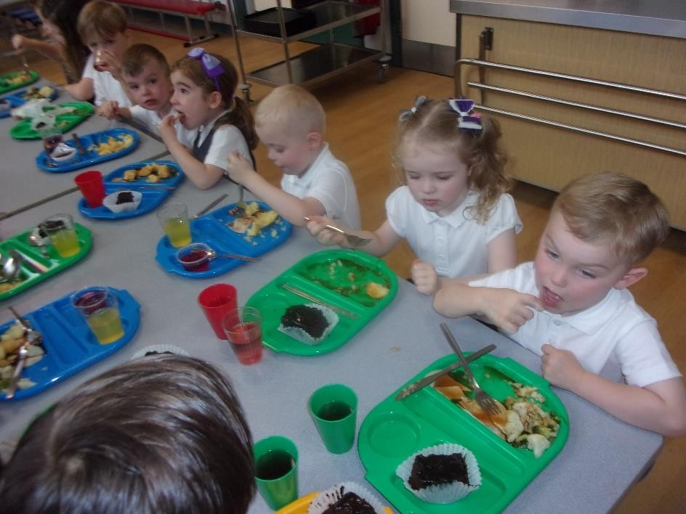
Lunch
Children eat their lunch in the school hall. They have 30 minutes to eat in the hall and 30 minutes play.
All children in Reception are entitled to a free school meal. We offer a range of hot meals, there are always 2 hot choices, baked potato and a full salad bar. Cold sandwiches are available too.
Your child is welcome to bring a packed lunch to school with them from home if you prefer.

Slide 20
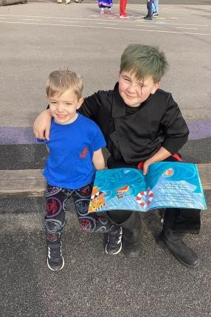
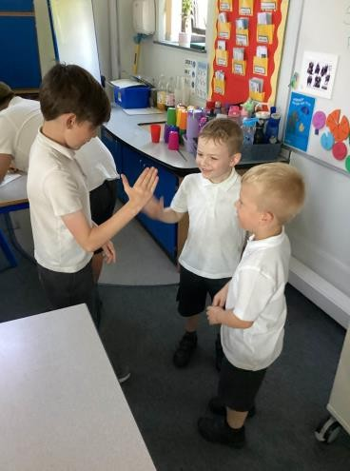
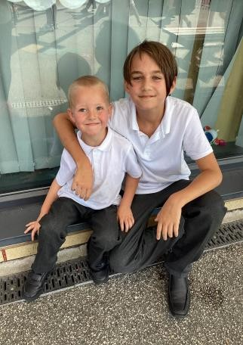
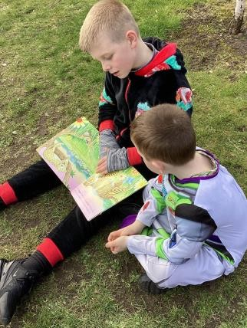

Year 6 Buddies
Our children are assigned a buddy in Year Six. We take part in play dates with them throughout the year.

Slide 21



Educational Trips and Visitors
This year the children have had visits from:
North West Ambulance
North West Police
North West Fire Service
Jude Lennon – Children’s Author
As part of our Spring topic minibeasts, the children visited-
Martin Mere

Slide 22
Breakfast Club
We have a school Breakfast Club which is open from 7.45am
Places are limited and you will need to pre-book.
Our Breakfast Club is free of charge at the moment.
After School Club
We have an After School Club provided by Fun 4 Kidz.
You will need to book your sessions with them on :
0151 932 9218

Slide 23

School Website
Our school website is www.springwellparkprimary.co.uk
Our website provides you with information, such as dates of events.

Slide 24

X- @SpringwellRecep

Slide 25
Thank you
If you have any questions please do not hesitate
to give school a call.
We look forward to welcoming you to
Reception.

