Slide 1

Welcome to Year 6

Slide 2
Staff
Class Teachers – Miss Carroll//Miss Boughey
Teaching Assistants - Mrs O’Neill/Miss Smith

Slide 3
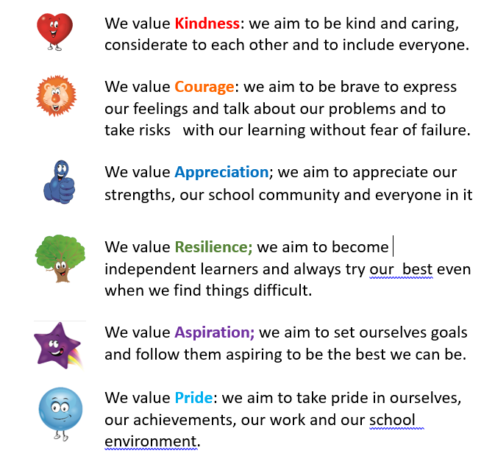
The Springwell Way

Slide 4
Behaviour
Our school values remain in place and children displaying these values will be rewarded using the our new Springwell Stars Recognition Board.
The Fab 50 will remain but children who demonstrate the right behaviour choices will be awarded a golden ticket to go in the class draw. The class teacher will then pull a ticket from the draw at the end of the term.

Slide 5
Start of the day - In order to reduce congestion on arrival at school, we will be opening the school doors from 8.30am. Teaching Assistants will be in class to support the children from 8.30. The pastoral team will be on duty at the side door- (Late door) to ensure the children enter calmly and assist with any questions. EYFS and KS1 will enter from their classroom doors. The playground gates will be locked at 8.50am. Children arriving after 8.50am must report to the front desk.
End of the day
Year | Exit | Time
Little Explorers | Class door | 3.30pm
Nursery | Class door | 3.30pm
Reception | Class door | 3.10pm
Year 1 | Class door | 3.10pm
Year 2 | Class door | 3.10pm
Year 3 | Main door onto the playground | 3.15pm
Year 4 | Exit via the fire door onto the Family well-being Centre car park | 3.15pm
Year 5 | Main door onto the playground | 3.20pm
Year 6 | Exit via the fire door onto the Family well-being Centre car park (Please stand back as Y4 will be exiting first) | 3.20pm

Slide 6
Breakfast Club
Breakfast club is available but must be pre-booked. Drop-ins will no longer be allowed.
Children will not be allowed to enter breakfast club after 8.20am, as the staff will be tidying up, ready to return to class at 8.30am. The pastoral team will have cereal bars for vulnerable children who have not had any breakfast.
Children can not sign themselves in. A member of staff will mark them on the register.
After School Club
Fun4Kidz will be running our After School Club. Please contact them directly on 01519329218 to arrange a place.

Slide 7
Dinner
We now have a contactless system for paying for school lunches. Therefore, we would appreciate it if you could pay for school lunches in advance on SIMS pay. Please see the school office about this.
Sefton catering have increased the price of school lunches. It now costs £2.30 per day for a school lunch. (£11.50 per week)
Mobile Phones
Walking Home Alone

Slide 8
Uniform
Children are to wear full school uniform to school everyday
Uniform for pupils
White polo shirt
Purple cardigan / sweatshirt with school logo
Grey trousers / skirt / pinafore
Purple gingham/striped dress in summer
Grey shorts may be worn in summer
Black shoes (Trainers are not to be worn)
Children are asked not to bring any items in from home except a water bottle with their name on.

Slide 9
PE
Our PE day for will be
Children are to come into school in their PE kit on their PE day. They can wear a tracksuit if the weather is cold. It should be black or dark blue.
PE
In the infants children will need:
A purple t-shirt with school logo
Black shorts
Black pumps / trainers
In the juniors children will need:
A t-shirt in the colour team they belong to (this will be explained to the children at the end of year 2)
Black shorts
Black pumps / trainers

Slide 10
Curriculum
Our topics for this year are:
 | Autumn | Spring | Summer
History |  | What kind of civilisation were the Maya? | What was the impact of slavery now and then?
Geography | How is Coniston similar to but different from Bootle and the Peloponnese?
Science | Light Electricity | Evolution and Inheritance | Living things and their habitats Animals including humans

Slide 11
Homework
Children are expected to read their reading book every day.
They will also be given knowledge organisers to help them develop their understanding of the geography/history topic they are studying.
The Knowledge Organiser is a document which shows what the learning will be that half term and gives children a chance to do some further research and reading at home. Over time, students will build up a core bank of facts and vocabulary that will help them excel in their achievements and understand the world around them.
In addition they will have number facts and spellings – it is crucial that you help your child with this at home.
We may also send some additional activities if necessary.

Slide 12
Communication
Please contact school using the main school reception where possible. Dojo may also be used but class teachers will not check this when teaching and will not look at messages after their working day has finished.
Key information and updates will be put on the class story and the class twitter feed.

Slide 13

Early Reading – Decodable books
Children who are being taught phonics will have a phonetically decodable book.
The children should not struggle with their book – it only contains sounds that the children have been taught. It should consolidate their learning.
The storybooks contain green and red words:
Green words
Green words are words that the children will be able to sound out and then sound blend together, using the speed sounds they have learnt.
Red words
Red words are those words which contain spelling patterns that cannot be sounded out. Some of the most frequently used words in the English language have an uncommon spelling pattern and don't sound like they look, for example, said sounds like ‘sed’.
Red words have to be learnt by sight. In the past, they have been referred to as ‘common exception words’, ‘sight words’ or ‘tricky words’.
Some ‘red words’ aren’t permeant red words and are ‘red for a while words’. This means that the word includes graphemes that have not been taught by the time they are encountered by the child.
Once the grapheme has been taught, some red words turn into green words.

Slide 14
Early Reading – Decodable books
The phonetically decodable book will be introduced in the 30 minute phonic session.
Children will read the story three times at school before it gets sent home.
First read – accurate word reading. Children review the sounds that will feature within the story (inside cover) and read the story accurately and slowly.
Second read – Developing fluency. Children increase their reading fluency (speed)
Third read – comprehension. Children discuss the story and engage in book talk. Can they summarise what has been read and talk about the characters and plot?
After the third read, your child will bring this book home as well as the matching book-bag book.

Slide 15

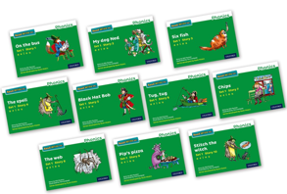
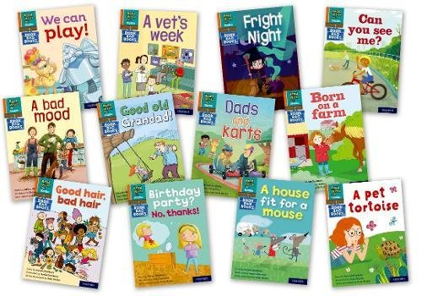





Early Reading – Decodable books
Reading for Pleasure text
Decodable story book
Book bag book

Slide 16


‘Special Friends’, ‘Fred Talk’, read the word
Early Reading – listening to your child read
Children will be able to read all of the words in the Storybook.
If they hesitate, remind them to read the word using ‘Special Friends, Fred Talk, read the word’.
For example, this means they spot the ‘sh’, then Fred Talk and blend to read the word e.g. sh, sh-i-p, ship.

