Slide 1
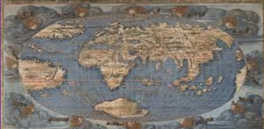

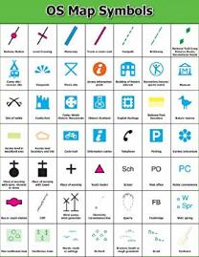
Y6 Geography-Why is Coniston similar to, but different from Bootle and The Peloponnese?
Subject Specific Vocabulary |  |  | Exciting Books
Ordnance Survey | An Ordnance Survey map is a detailed map produced by mapping agency of the United Kingdom (UK).
symbol | Map symbols are used to represent real objects. Both shapes and colours can be used for symbols on maps.
grid reference | Numerical grid references consist of an even number of digits. Eastings are written before Northings. | Sticky Knowledge about Map Reading
peak | The peak is the highest point of any mountain. | Cartography is the study of maps and map making. Someone who makes maps is called a cartographer.
valley | A valley is a long depression, or ditch, in the Earth's surface and usually lies between ranges of hills or mountains. | There are two norths: true north and magnetic north. True north is the direction of the geographic North Pole. Magnetic north is the direction the north end of a needle in a compass points.
cliff | Cliffs are tall, steep rocks that were created by erosion and have vertical faces.
ridge | A ridge is part of the steep, sloping side of a mountain. | Throughout Medieval times in Europe most maps of the world, known as Mappae Mundi, were expensive to create by hand, so were used by royals and nobles as displays of wealth rather than for practical purposes.
plateau | A plateau is an area of flat ground that is much higher than the surrounding area.
summit | The summit is the highest point of a mountain.
hill | A hill is a landform that is high but not high enough to be a mountain. | The world map that is familiar to most of us is the Mercator projection, but it is full of distortions so some countries appear larger or smaller than they actually are.
terrain | Terrain is used as a general term when referring to the lie of the land.
 |  | North may be at the top of maps today, but that wasn’t always the case. During the middle ages, most Western maps put east at the top instead.
summit | The summit is the highest point of a mountain.

