Slide 1
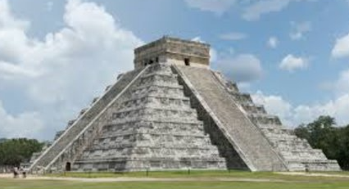
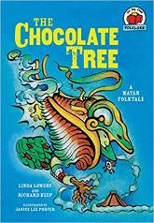
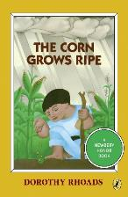
Maya Civilisation: KS2 Knowledge Mat
Subject Specific Vocabulary |  | Each symbol represents a letter or sound | Exciting Books
glyphs | Symbols used in the Mayan writing system. Each symbol represents a word or sound.
codices | Books created by the Mayans. They were made of soft bark and folded like a fan.
Chichen Itza | The Mayans most well-known pyramid.
cacao | Seeds that the Maya used to make chocolate. | Sticky Knowledge about the Maya civilization
ahau or ahaw | The main king or lord of a Maya city-state.
 |  | The Maya were expert mathematicians and astronomers. They used this expertise to make calendars.
batab | A lesser lord, usually ruling over a small town. | Although the Maya had metal-working skills, metal ores were scarce. Maya used stone tools to carve the limestone that they used for their buildings.
Itzamna | The main god of the Maya, Itzamna was the god of fire who created the Earth.
 |  | Mayan religion was extremely bloodthirsty, demanding human sacrifices and blood-letting rituals. The Maya believed in an afterlife and that those who were sacrificed, as well as those killed in war and women who died in childbirth, went to ‘the place of misty sky’.
huipil | A traditional garment worn by Maya women.
Kin | Word representing a day in the Maya calendar. | At the top of Maya society was the king and royal family who were believed to be closely linked to the gods. An educated elite of scribes, priests and nobles formed the ruling class. They occupied the finest buildings in the city.
Kukulcan | The serpent god of the Maya. One of the primary gods, especially to the Itza peoples of Chichen Itza.
Uinal | Word for a month in the Maya calendar. It was 20 days long. | Maya society was formed of a number of city states each with their own ruler.
The maya people made their home in an area known as Mesoamerica (modern day Mexico and Central America). Maya culture was well established by 1000 BCE, and it lasted until 1697.

