Slide 1

Welcome to Year 3

Slide 2
Staff
3T
Class Teacher – Miss Taylor
Teaching Assistants – Mrs Reynolds (Monday) Mrs Jones (Tuesday-Friday)
3L
Class Teacher – Mr Lord
Teaching Assistant – Mrs Smith

Slide 3
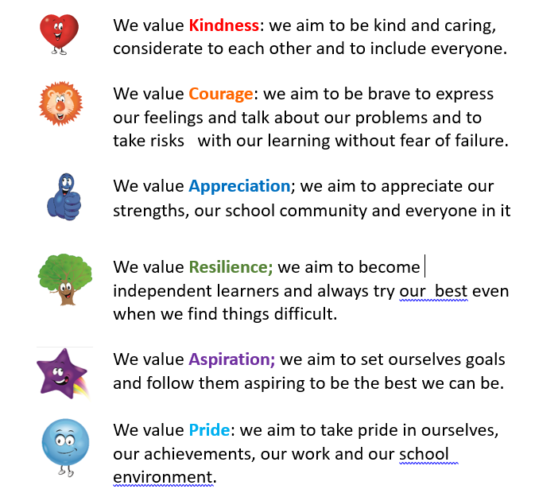
The Springwell Way

Slide 4
Behaviour
Our school values remain in place and children displaying these values will be placed on the recognition board.
Children will not be removed from the recognition board once they are on it. They will get a Golden Ticket at the end of the day.
Golden Tickets

Slide 5
Sanctions
LEVEL 1 (class staff intervention)
Reminder
Quiet chat
De-escalation strategies
Phone call home
LEVEL 2 (pastoral team intervention)
Loss of privileges - playtime
Meet with parents
Learning Mentor intervention (Mrs Sweeney)
LEVEL 3 (management team intervention)
Reflection room
Meeting with parents and pastoral team
Behaviour plan
External agency involvement
LEVEL 4
Exclusion

Slide 6
Fab 50
Fab 50s will be given as golden tickets.
At the end of term, 3 raffle tickets will be draw from the box. These children will go on the Fab 50 trip. The more tickets a child has, the more chance they have of being picked for the trip.

Slide 7
Start of the day - In order to reduce congestion on arrival at school, we will be opening the school doors from 8.30am. Teaching Assistants will be in class to support the children from 8.30. The pastoral team will be on duty at the side door- (Late door) to ensure the children enter calmly and assist with any questions. The playground gates will be locked at 8.50am. Children arriving after 8.50am must report to the front desk.
End of the day
Year | Exit | Time
Little Explorers | Class door | 3.30pm
Nursery | Class door | 3.30pm
Reception | Class door | 3.15pm
Year 1 | Class door | 3.15pm
Year 2 | Class door | 3.15pm
Year 3 | Main door onto the playground | 3.15pm
Year 4 | Exit via the fire door onto the Family well-being Centre car park | 3.15pm
Year 5 | Main door onto the playground | 3.20pm
Year 6 | Exit via the fire door onto the Family well-being Centre car park (Please stand back as Y4 will be exiting first) | 3.20pm

Slide 8
Breakfast Club
Breakfast club is available but must be pre-booked. Drop-ins will no longer be allowed.
Children will not be allowed to enter breakfast club after 8.20am, as the staff will be tidying up, ready to return to class at 8.30am. The pastoral team will have cereal bars for vulnerable children who have not had any breakfast.
Children can not sign themselves in. A member of staff will mark them on the register.
After School Club
Fun4Kidz will be running our After School Club. Please contact them directly on 01519329218 to arrange a place.

Slide 9
Dinner
We now have a contactless system for paying for school lunches. Therefore, we would appreciate it if you could pay for school lunches in advance on Arbour. Please see the school office about this.
Alternatively, you can pay in cash at the School Office.
Sefton catering have increased the price of school lunches. It now costs £2.53 per day for a school lunch. (£12.65 per week)

Slide 10
Uniform
Children are to wear full school uniform to school everyday
Uniform for pupils
White polo shirt
Purple cardigan / sweatshirt with school logo
Grey trousers / skirt / pinafore
Purple gingham/striped dress in summer
Grey shorts may be worn in summer
Black shoes (Trainers are not to be worn)
Long hair should be tied up.
Children are asked not to bring any items in from home except a water bottle with their name on.

Slide 11
PE
Our PE day will be Friday
Children can come into school in their PE kit on their PE day only. They can wear a tracksuit if the weather is cold. This should be black or dark blue.
PE
In the juniors the children will need:
Purple t-shirt
Black shorts
Black pumps / trainers

Slide 12
Curriculum Our topics for this year are:
 | Autumn | Spring | Summer
History | Early Britons | Romans
Geography |  |  | Summer 1 What’s it like to live in Bootle? Summer 2 What’s it like to live in the shadow of a volcano?
Science | Autumn1 Light and Dark Autumn 2 Forces and Magnets | Animals including Humans | Summer 1 Plants Summer 2 Rocks and Soils

Slide 13
In order to help our children ‘progress’, pupils will be reminded of our high expectations from the outset. In key stage 2, we will be prioritising identifying gaps and re-establishing good progress in the basic skills (phonics and reading, increasing vocabulary, writing and mathematics), identifying opportunities across the curriculum so they read widely, and developing their knowledge and vocabulary.
Our curriculum will remain broad, so that the majority of pupils are taught a full range of subjects over the year.
With a tight curriculum in year 3, we rely on home support for reading, times tables practice and spelling practice.

Slide 14
Homework
Children are expected to read their reading book every day. In Y3 the emphasis is on reading comprehension rather than word reading.
We have Springwell Reads loyalty points. 1 point is awarded for reading 5 days in a week. Children who fill their card will get a prize.
There will be weekly spelling tests - every Tuesday.
There will also be a number facts test - every Friday.
In their homework books, there are knowledge organisers to help children to develop their understanding of the geography/history and science topic they are studying.
We may also send some ‘catch up’ activities if necessary - such as handwriting, times tables, etc.
CHILDREN SHOULD BRING THEIR HOMEWORK BOOK TO SCHOOL EACH WEEK.

Slide 15

Early Reading – Decodable books
Children who are being taught phonics will have a phonetically decodable book.
The children should not struggle with their book – it should only contain sounds that the children have been taught. It should consolidate their learning.
The storybooks contain green and red words:
Green words
Green words are words that the children will be able to sound out and then sound blend together, using the speed sounds they have learnt.
Red words
Red words are those words which contain spelling patterns that cannot be sounded out. Some of the most frequently used words in the English language have an uncommon spelling pattern and don't sound like they look, for example, said sounds like ‘sed’.
Red words have to be learnt by sight. In the past, they have been referred to as ‘common exception words’, ‘sight words’ or ‘tricky words’.
Some ‘red words’ aren’t permanent red words and are ‘red for a while words’. This means that the word includes graphemes that have not been taught by the time they are encountered by the child.
Once the grapheme has been taught, some red words turn into green words.

Slide 16
Early Reading – Decodable books
The phonetically decodable book will be introduced in the 30 minute phonic session.
Children will read the story three times at school before it gets sent home.
First read – accurate word reading. Children review the sounds that will feature within the story (inside cover) and read the story accurately and slowly.
Second read – Developing fluency. Children increase their reading fluency (speed)
Third read – comprehension. Children discuss the story and engage in book talk. Can they summarise what has been read and talk about the characters and plot?
After the third read, your child will bring this book home as well as the matching book-bag book.

Slide 17


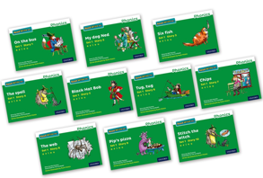
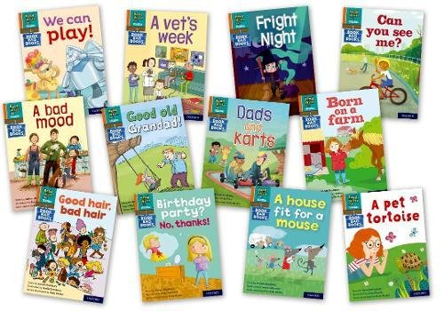




Early Reading – Decodable books
Reading for Pleasure text
Decodable story book
Book bag book

Slide 18


‘Special Friends’, ‘Fred Talk’, read the word
Early Reading – listening to your child read
Children will be able to read all of the words in the Storybook.
If they hesitate, remind them to read the word using ‘Special Friends, Fred Talk, read the word’.
For example, this means they spot the ‘sh’, then Fred Talk and blend to read the word e.g. sh, sh-i-p, ship.

Slide 19
Assessment
All statutory assessments will take place in the academic year 24/25 in accordance with the usual timetables.
The Y3 tests are as follows:
Maths - Arithmetic and Reasoning
Reading comprehension
Grammar, Punctuation and Spellings
Reading age (Lexplore)

Slide 20
Communication
Please contact the school office if you have any queries or concerns.
Alternatively, you can speak to your child’s class teacher at the end of the day.
Sharon or Gail are around at the end of the day if you need to speak to them.

Slide 21
Thank you!

