Slide 1
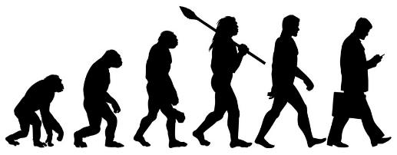
Year 6: Evolution & Inheritance Knowledge Mat
Subject Specific Vocabulary |  | Interesting Book | Sticky Knowledge about evolution & inheritance
off-spring | When living things reproduce they pass on characteristics to their offspring. All living things produce offspring of the same kind, but normally offspring are not identical to their parents
 |  |  | Evolution is a scientific theory used by biologists. It explains how living things changed over a long time, and how they have come to be the way they are.
adaptation | Adaptation is the process by which animals, plants and other living things have changed so that they better suit their habitat.
evolution | Evolution is the theory that all the kinds of living things that exist today developed from earlier types. |  | We know that living things have changed over time, because we can see their remains in the rocks.
inheritance | When living things reproduce they pass on characteristics to their offspring. This is known as inheritance. |  | We know that the animals and plants of today are different from those of long ago.
palaeontologist | A palaeontologist is someone studying the life of past geological periods, as known from fossil remains. |  | Evolutionary questions are still being actively researched by biologists.
Charles Darwin | Charles Darwin was an English scientist who studied nature. He is known for his theory of evolution.
Charles Darwin | Charles Darwin was an English scientist who studied nature. He is known for his theory of evolution
genes | Genes that are passed on to you determine many of your traits, such as your hair colour and skin colour.
chromosomes | Chromosomes are tiny structures inside cells made from DNA and protein.
syndrome | A syndrome is a genetic condition which can affect learning and physical features.
genotype | A genotype refers to a particular gene or set of genes carried by an individual.

