Slide 1
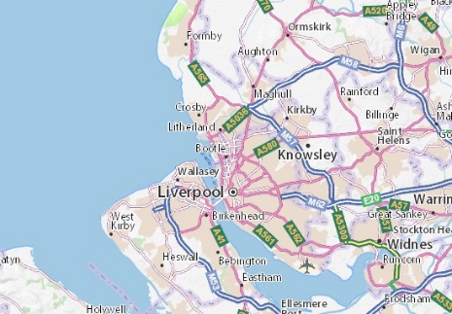
What’s it like to live in Bootle? Knowledge Organiser Y3 Spring
Subject Specific Vocabulary |  |  | Exciting Books
Equator | The equator is an imaginary line around the centre of the Earth. It runs East to west half between the North and South poles. |  | Her Benny
Latitude | Is a way to say where a place is on the earth. It is a region marked by its’ distance North or South of the Equator.
Longitude | Is a way to say where a place is on the earth. It is measured from an imaginary North South line called the Prime meridian
Northern Hemisphere | The equator divides the Earth into two equal parts. The top part is called the Northern Hemisphere. | Knowledge you should know by the end of this topic
 |  |  | Some Major UK Cities
Southern Hemisphere | The equator divides the Earth into two equal parts. The bottom part is called the Southern Hemisphere. | Where Bootle is in the UK in relation to some major cities and some counties. Where Bootle is in the World. What Bootle is like both in terms of its’ human and physical characteristics. How Bootle has changed over time. Also, I should also be able to express my views about Bootle ie my likes and dislikes.
 |  |  | Liverpool London Edinburgh Birmingham Manchester
Climate Zone | Climate zones are areas with distinct climates which occur in an East to west direction around the earth.
Settlement | A settlement is any form of human dwelling ranging from the smallest house to the largest city.
Land Use | Land use is when land is used for a specific purpose – residential, farming, recreation, transportation and commercial. |  | Counties near to Bootle
Map | A map is a drawing of all or part of the earth’s surface to show where things are.
 |  |  | Merseyside Lancashire Cheshire Greater Manchester
Map Scale | Map Scale is the relationship between distance on a map and distance in real life.
Aerial photograph | Aerial photography is the process of taking photographs of an area from above.

