Slide 1
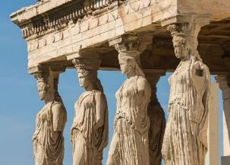
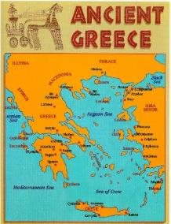


Ancient Greeks Year 5 Knowledge Mat
Subject Specific Vocabulary |  |  | Where is Greece?
philosophy | Philosophy is a way of thinking about the world, the universe, and society.
Athenians | It is the birth place of democracy and the heart of the Ancient Greek civilisation.
Spartans | The Spartans believed that strict discipline and a tough upbringing was the secret to making the best soldiers.
democracy | Democracy means allowing citizens to make their own decisions for their personal lives.
 |  | Sticky Knowledge about Ancient Greece ( 700-480 B.C)
Olympics | The ancient Olympic Games were originally a festival, or celebration of Zeus.
Zeus | Zeus is the Olympian god of the sky and the thunder, the king of all other gods and men. | The Ancient Greeks invented the theatre because they loved watching plays, and most cities had a theatre.
culture | A pattern of behaviour shared by a society or a group of people. |  | Exciting Books
 |  | Events at the Greek’s Olympics included wrestling, boxing, long jump, javelin, discus and chariot racing.
Settlements | A small community of people.
Inventions | New things that are created or made. | The Ancient Greeks held many festivals in honour of their gods.
 |  | Most Ancient Greeks wore a chiton, which was a long T-shirt made from one large piece of cotton. The poor slaves, however, had to make do with a loincloth.
Athene | Greek goddess of wisdom and war.
slavery | People that worked for their owners.
temple | A building devoted to the worship of a god or gods.

