Slide 1
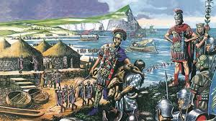
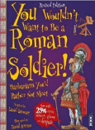
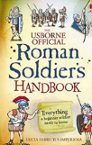
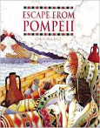
The Romans KS2 Knowledge Organiser
Subject Specific Vocabulary |  |  | Exciting Books
Rome | The capital city of Italy and where the Romans came from.
emperor | The Roman leader of the Roman Empire during the imperial period.
aqueduct | A large system, like a bridge, for carrying water from one place to another is called an aqueduct.
hypocaust | A central heating system invented in Roman times.
gladiator | A gladiator was an armed fighter who entertained audiences in the Roman Republic.
 |  | Sticky Knowledge about the Romans
 |  | Julius Caesar was probably the best known Roman leader. He extended the empire by invading other lands. He made 2 failed attempts to conquer Britain in 55BC and 54BC. Claudius made a successful third attempt in 43AD and Britain became part of the Roman Empire.
Londinium | This was the Roman name for London.
Centurion | A commander of a group of 100 Roman soldiers.
Chariot | A small horse drawn carriage that the Romans used for racing. | A legend tells that Rome was created by two brothers, Romulus and Remus who were abandoned after they were born. | Important Places
legion | A section of the Roman army containing 5000 men. | Romans used to eat strange foods like dormice dipped in honey. Romans occasionally used a spoon, but they would never use a knife and fork. Rich Romans liked to eat exotic food, such as stork, roast parrot and even flamingo! | Colosseum An oval amphitheatre in the centre of Rome which held up to 50,000 people. Hadrian’s Wall A long wall built by the Romans across the north of England. It was to keep out the Picts. It is now one of Britain’s most famous tourist attractions.
senate . | Similar to the Roman version of our parliament. | The Roman Empire eventually began to collapse, and the Romans left Britain in 410AD to return to Rome to protect it. The Anglo Saxons invaded and conquered Britain shortly after.
Roman baths . | A number of rooms designed for bathing, relaxing, and socialising, as used in ancient Rome. | When the Romans came to Britain they helped us by creating roads; a written language (which was Latin); introducing coins and even introducing rabbits to our country.

