Slide 1
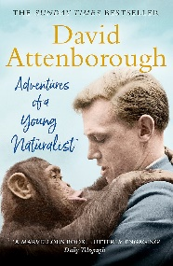
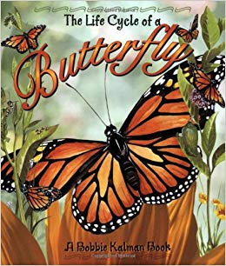
Year 5: All living things and their habitats Knowledge Mat
Subject Specific Vocabulary |  | Interesting Books | Sticky Knowledge about Life Cycles
Mammal | A mammal is an animal that breathes air, has a backbone, and grows hair at some point during its life.
 |  |  | Plants are able to reproduce in two different ways - sexual reproduction and asexual reproduction.
Amphibian | They live the first part of their lives in the water and the last part on the land. When they hatch from their eggs, amphibians have gills so they can breathe in the water.
Insect | Insects are creatures that have bodies with three segments that are protected by a hard shell. | Important facts to know by the end of the life cycles topic: | Pollination is the process that allows plants to reproduce. In some cases, the wind and rain blows pollen between plants, which causes pollen to transfer to the female reproductive part of the plant.
Bird | All birds belong to the group of animals called vertebrates, meaning animals having a backbone.
Naturalist | An expert of Natural History. For example: David Attenborough. |  | Many insects have four stages in their life cycle: egg or the unborn stage; larva – young stage; pupa – inactive (no feeding) stage; and adult stage.
Habitat | The natural home or environment of an animal, plant, or other organism. | Know the life cycle of different living things, e.g. mammal, amphibian, insect and bird. Know the differences between different life cycles. Know the process of reproduction in plants. Know the process of reproduction in animals.
Environment | The surroundings or conditions in which a person, animal, or plant lives or operates.
 |  |  | In general, the life cycles of plants and animals have three basic stages including a fertilised egg or seed, immature juvenile, and adult. However, some organisms may have more than three life cycle stages, and the exact names of each stage can slightly differ depending on the species.
Classification | This is the grouping together of similar species of plant, animal and other organisms.
Reproduction | Reproduction is the way different plants and animals make new plants and animals. The reproduction system differs in plants and animals.

Slide 2
Year 5: Animals, including humans Knowledge Mat
Subject Specific Vocabulary |  | Interesting Books | Sticky Knowledge about animals, including humans
Life cycle | The series of changes in the life of an organism including reproduction. | Human life cycles- Anita Ganeri The human life cycle- Jennifer Prior
 |  |  | There are many stages of the human life cycle including: baby, childhood, adolescence, adulthood and old age.
Gestation | The period of time that a mammal carries her offspring or babies inside her body before giving birth.
Baby | A very young child.
Childhood | The state or period of being a child. | Important facts to know by the end of the animals, including humans topic: | As humans grow and develop from a baby to childhood they will learn to walk and talk.
Adolescence | The period of life when a child develops into an adult.
Adulthood | The state or condition of being fully grown or mature. |  | As humans reach old age they may experience changes such as hair loss, hair turning grey, a decline in fitness and health.
Old age | The state of being old. | Know about the stages in the growth and development of humans. Know the changes that take place as humans develop to old age. Know about the changes experienced in puberty.
Puberty | When a child’s body begins to develop and change as they become an adult.
Timeline | A graphical representation of a period of time, on which important events are marked.
Mammal | A mammal is an animal that breathes air, has a backbone, and grows hair at some point during its life.

