Slide 1
Online Safety

Slide 2
What is online safety?
In simple terms, Online safety is the act of ensuring you and the people you care for are safe while they are online. It can also be referred to as E-Safety, Internet Safety, or Cyber Safety.
Online Safety encompasses all technological devices that have access to the internet, including but not limited to: desktops, laptops, tablets, consoles, and mobile phones.
Being safe online means individuals are protecting themselves and others from online harms and risks, including stranger dangers, disclosing personal information, or cyber bullying (bullying which occurs online).

Slide 3
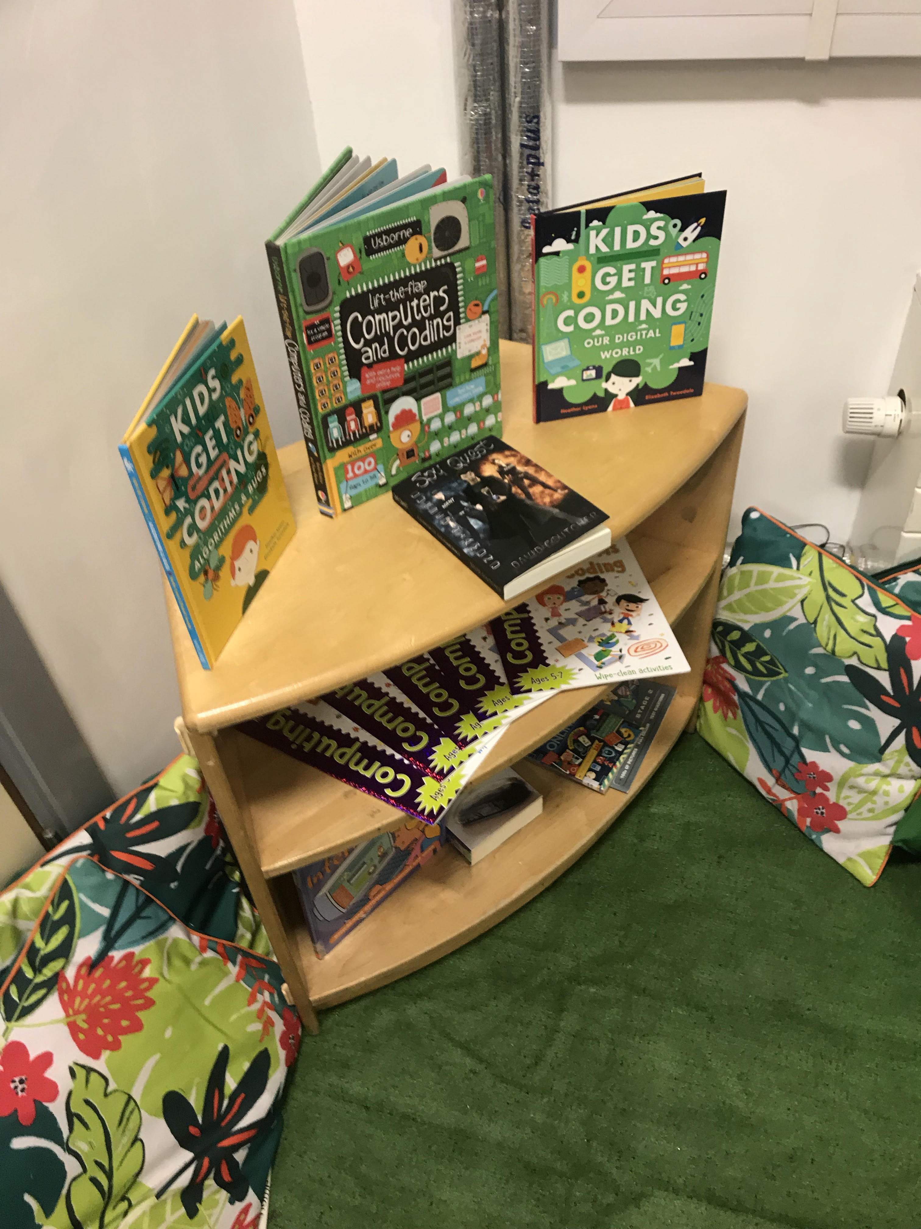
E-Safety at Springwell Park
Ensuring that our children are safe while they are online is of utmost importance to us at Springwell Park. At Springwell, E-Safety is not limited to one focus day a year. It is an active part of our curriculum, where it is spoken about and revisited often.
Our computing curriculum has an E-Safety slot timetabled at the start of every new computing unit, where the children revisit and consolidate their knowledge before accessing the technology.
Our Computer Room has an interactive display, where children can update their knowledge on the multitude of social media, including their dangers, age limits and what needs to be considered.
Our Computer Room also has a Reading Area. This contains various child friendly books about computing and E-Safety.
Our pupils need to read, understand, and sign a Pupil Agreement in the Autumn term, whereby they agree to abide by our E-Safety rules.
We celebrate National E-Safety Day annually, where we are off time table and complete computing and internet safety activities, including an assembly.
We celebrate internet safety within our PSHE week.
Classrooms and key stage corridors have E-Safety displays, with GR codes and vocabulary displayed.
I conduct annual pupil and parental questionnaires, including pupil interviews.

Slide 4
E-Safety at Home
What the children have access to online is forever growing. This is why it is important for us as teachers and parents/carers to understand what our children are going on, the dangers and implications these sites could have, and how we can do our best to ensure our children are safe.
The vast majority of social media sites does have the option for parental controls and safety settings. This greatly reduces (but does not completely eliminate) the risks that are synonymous with online use. These parental controls can be found in the settings on the social media app.
Each social media/game has got a unique minimum age requirement. This is not randomly generated. Each platform has been individually scrutinised and assessed against a ‘risk generator’.
On the following pages, there will be a mini fact file on the most popular social media and trends that are active currently.

Slide 5
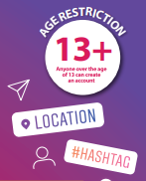
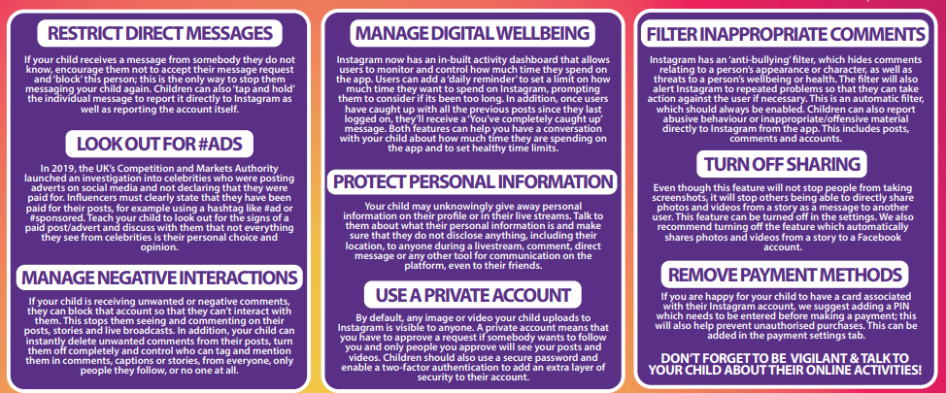
Instagram
Instagram is a hugely popular social networking app with over 1 billion users worldwide. The app allows users to upload images and videos to their feed, create interactive ‘stories’, exchange private messages or search, explore and follow other accounts they like. To make posts easier to find, users can include searchable hashtags and captions to their uploads.
Instagram has a minimum age requirement of 13. Children under 13 are now allowed to create an account.

Slide 6
TikTok
TikTok is a video sharing social media app, which lets users create, share, and view videos. Users can record and upload bite-sized looping videos of themselves lip-syncing and dancing to popular music. TikTok has been designed with the young person in mind and can become addictive. It has between 500 million and 1 billion active users every month.
TikTok has a minimum age requirement of 16.

Slide 7
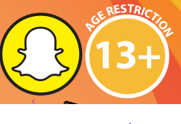
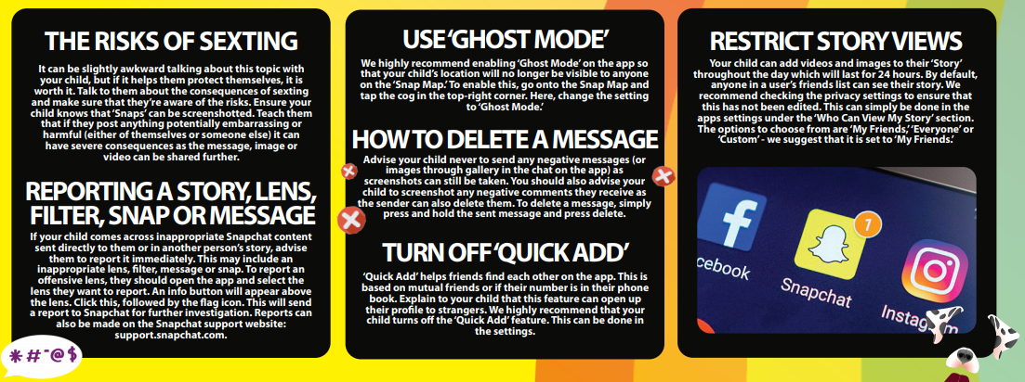
Snapchat
Snapchat is a photo sharing app for mobile phones and tablets. The app allows users to share images, videos and chat with friends through voice call or text message. Users can share images and videos directly to specific friends, or through a ‘story’ shared with their entire friend list, which documents the previous 24 hours. In a study, Snapchat was ranked the 4th most negative app in terms of having an impact on young people’s health and wellbeing, with children feeling that they can use the app Snapchat to “make you look pretty.”
Snapchat has a minimum age requirement of 13.

Slide 8
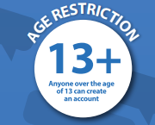
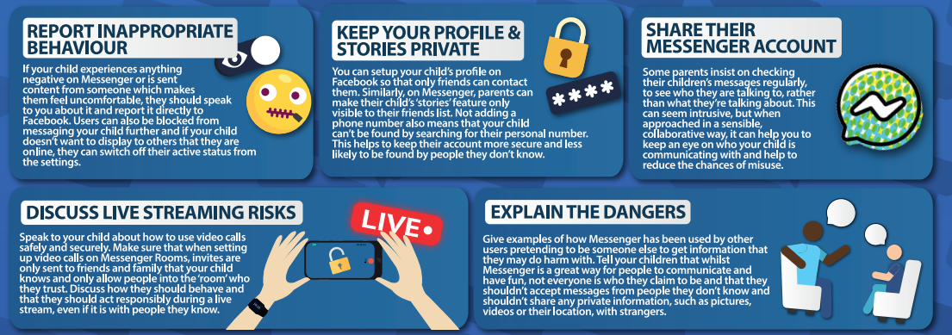
Facebook Messenger
Facebook Messenger is a communication and chat application which is part of the social media Facebook. Through Messenger, users can exchange messages, send photos, videos, audio files and GIFs. It allows for 1:1 chats, as well as group chats, including audio and video call.

Slide 9
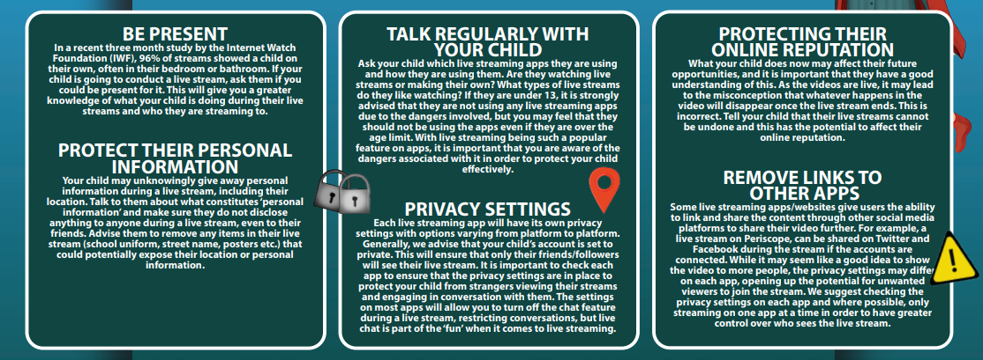
Live Streaming
Live streaming is the term used to describe the broadcast of a real time video from a mobile device, tablet or games console. Many live streaming apps have functionality for interactions from viewers, such as commenting, live chats and sending reactions during the broadcast. Live streaming opens up a world of excitement for children, where they can watch live concerts, their favourite celebrities and bloggers/vloggers, connect with their friends, watch live gaming and much, much more. Whilst there are many positives with live streaming, it creates a worldwide platform for unsuitable content to be streamed and creates a host of dangers for children.

Slide 10
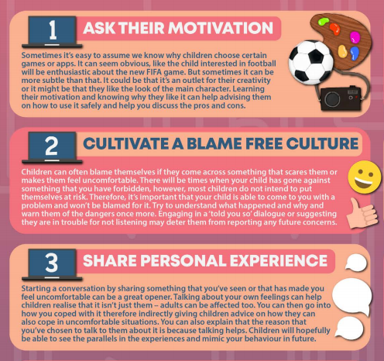
Conversation Starters for you and your child
Trying to start a conversation about online safety with children can be a daunting task. There are many reasons why children may not want to talk to adults about it. One might be that they will think we don’t understand, or wont know how to help. It can also be hard to start a conversation about something that you might have limited knowledge about. However, with screen time increasing during lockdown, it is important now more than ever, to be talking to children about what they are accessing online.

Slide 11
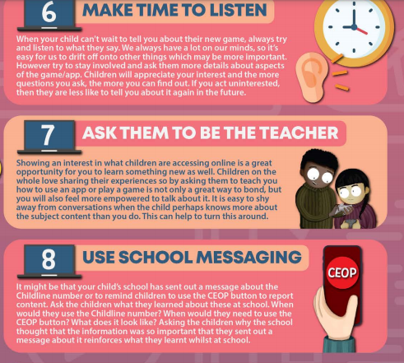
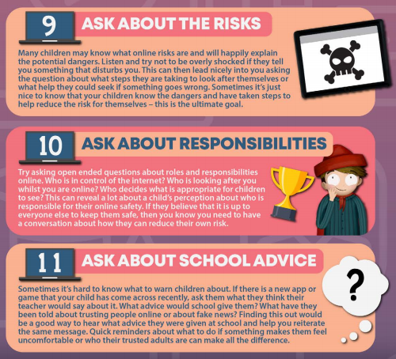
Conversation Starters for you and your child

Slide 12
Where to go for further information?
As a school, we have bought into National Online Safety. There are countless superb courses on there for parents, including guides, videos, quizzes and more. If you do not already have an account, please do not hesitate to ask me to create one for you. It would be my pleasure.
Our Springwell Park E-Safety page of the website has superb information on, including what you should be looking out for, what we do as a school to teach E-Safety, and a communication box, where you can get in touch with me.
If you have any questions, concerns or queries about E-Safety, again, please do not hesitate. You can reach me by emailing our school admin email address, and your query will be forwarded to me.
Thank you for taking the time to read this PowerPoint.

