Slide 1

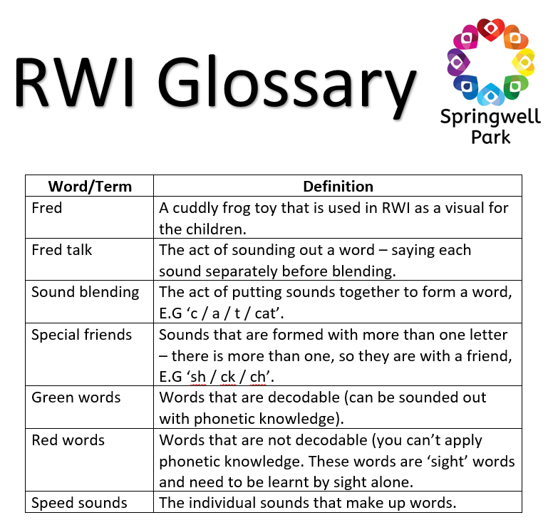
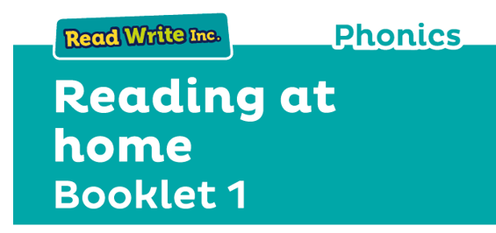
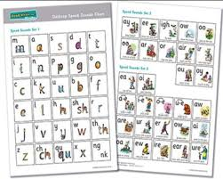
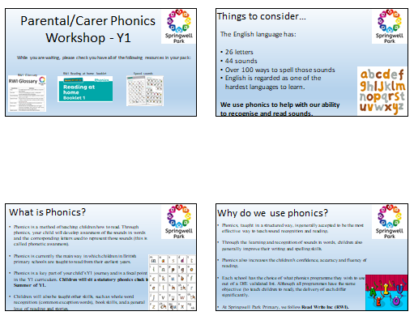
Parental/Carer Phonics Workshop - Y1
While you are waiting, please check you have all of the following resources in your pack:
RWI Glossary
RWI Reading at home booklet
Speed sounds
PowerPoint handout

Slide 2

Things to consider…
The English language has:
26 letters
44 sounds
Over 100 ways to spell those sounds
English is regarded as one of the hardest languages to learn.
We use phonics to help with our ability to recognise and read sounds.

Slide 3
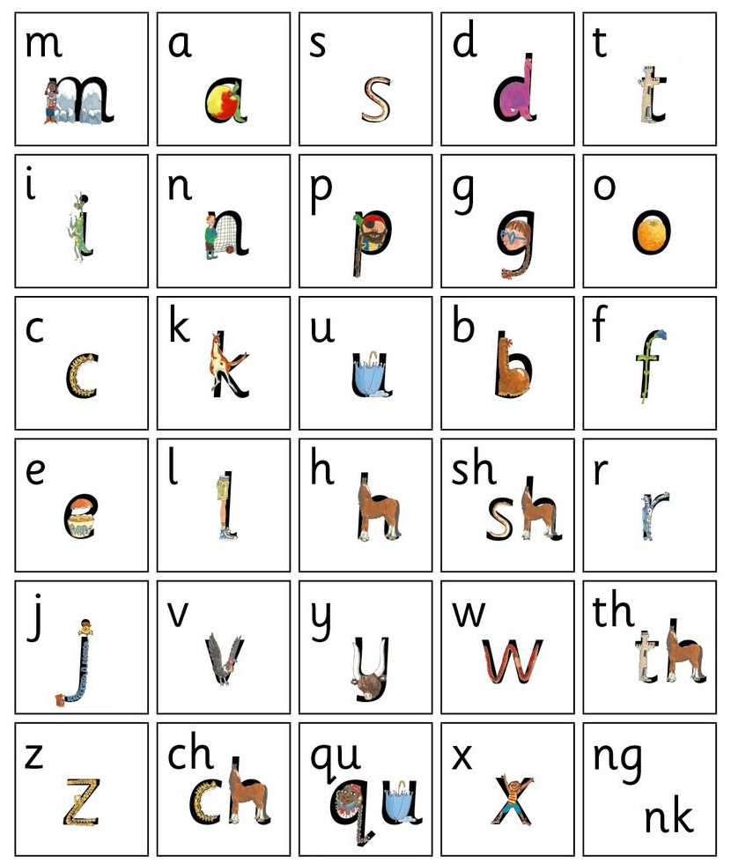
What is Phonics?
Phonics is a method of teaching children how to read. Through phonics, your child will develop awareness of the sounds in words and the corresponding letters used to represent those sounds (this is called phonetic awareness).
Phonics is currently the main way in which children in British primary schools are taught to read from their earliest years.
Phonics is a key part of your child’s Y1 journey and is a focal point in the Y1 curriculum. Children will sit a statutory phonics check in Summer of Y1.
Children will also be taught other skills, such as whole word recognition (common exception words), book skills, and a general love of reading and stories.

Slide 4

Why do we use phonics?
Phonics, taught in a structured way, is generally accepted to be the most effective way to teach sound recognition and reading.
Through the learning and recognition of sounds in words, children also generally improve their writing and spelling skills.
Phonics also increases the children’s confidence, accuracy and fluency of reading.
Each school has the choice of what phonics programme they wish to use out of a DfE validated list. Although all programmes have the same objective (to teach children to read), the delivery of each differ significantly.
At Springwell Park Primary, we follow Read Write Inc (RWI).

Slide 5
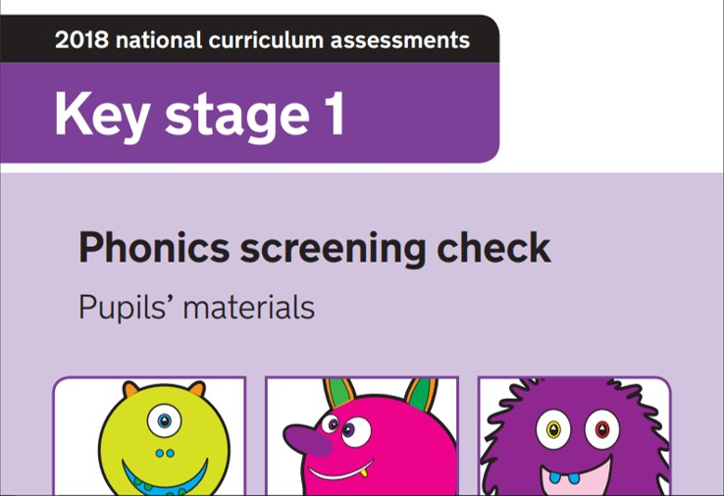
The Phonics Screening Check
What is the phonics screening check?
The phonics screening check is a statutory test that all Y1 children sit in the Summer term of Y1. The check is designed to assess if the child has reached the age appropriate standard of decoding for a Y1 child.
How is the check administered?
The check is administered on a 1:1 basis with the child and a teacher. It usually takes up to 10 minutes for the child to complete the check, however, there is no time limit and children can take as long as they need.
What does the check consist of?
The check consists of 40 words (20 of which are real words and 20 of which are ‘alien’ words). The alien words are presented to the children with a small illustration of an alien on – this signifies to the child that it is a nonsense word.
The words are presented to the children in the form of a booklet, with 4 large words per page. The words gradually get more difficult

Slide 6
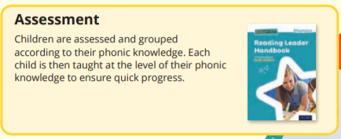
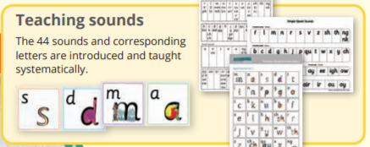
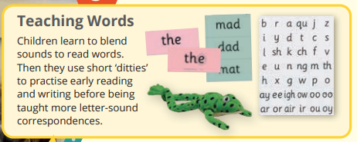
Why RWI?
Used in over 5,000 UK Primary schools, Read Write Inc. Phonics is a DfE validated Systematic Synthetic Phonics programme with a whole school approach to teaching early reading, designed to ensure progress for every child, in every primary school.
The benefits:
When using RWI to read the children will:
Learn to read effortlessly so that they can put all their energy into understanding what they read.
Learn 44 sounds and the corresponding letter/letter groups using simple picture prompts.
Learn to read words using Fred Talk.
Learn to read words by blending the sounds together.
Read lively stories featuring words they have learnt to sound out. • Show that they understand the stories by answering 'Find It' and 'Prove it' discussion questions.

Slide 7
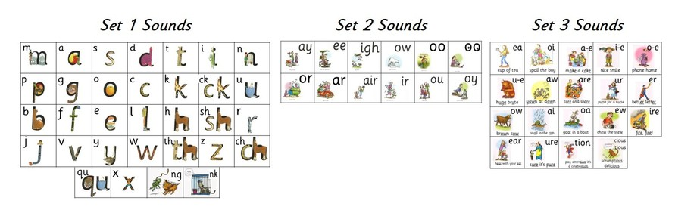
How does RWI work? What does your child’s phonics look like?
RWI is split into three sets. The children all begin with the ‘single sounds’ in Set 1 and progress through the sets as their understanding increases.
Our phonics sessions are grouped – the children will be grouped based on what understanding they have of the sounds that they have encountered.
We regularly assess the children and the children are moved accordingly to ensure that they are always appropriately challenged.
Children will encounter green and red words.
Your child will learn to read in a very simple way. He or she will learn to:
Read letters by their ‘sounds’.
Blend these sounds into words.
Read the words in a story.

Slide 8
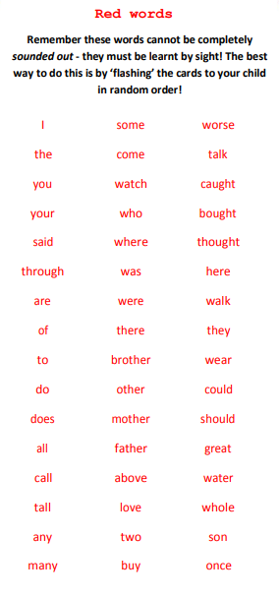
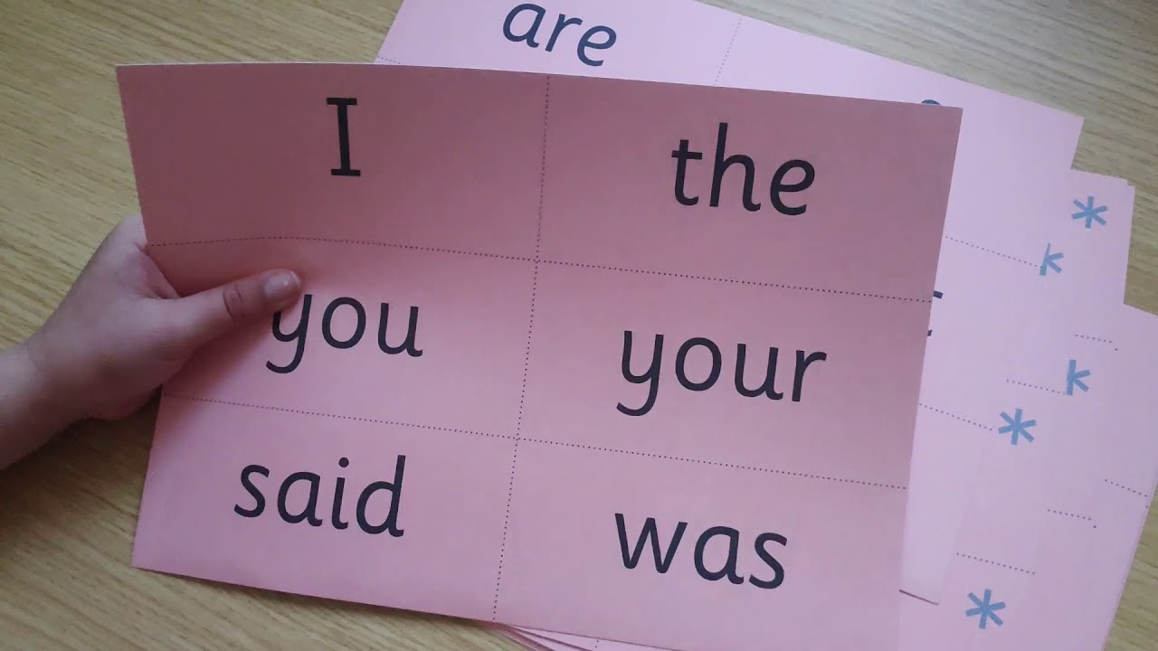
Red and green words
Green words
Green words are words that your child will be able to sound out and then sound blend together, using the speed sounds they have learnt. Your child will be able to read a book easier if they practice reading these words first.
Red words
Red words are those words which contain spelling patterns that cannot be sounded out. Some of the most frequently used words in the English language have an uncommon spelling pattern and don't sound like they look, for example, said sounds like ‘sed’.
Red words have to be learnt by sight. In the past, they have been referred to as ‘common exception words’, ‘sight words’ or ‘tricky words’.
Some ‘red words’ aren’t permeant red words and are ‘red for a while words’. This means that the word includes graphemes that have not been taught by the time they are encountered by the child.
Once the grapheme has been taught, some red words turn into green words.

Slide 9
Set 1
These are the Set 1 Speed Sounds written with one letter. These are called ‘single sounds’
m a s d t i n p g o c k u b f e l h r j v y w z x
When we teach these, we teach them as sounds and not names. We also teach the pure sounds to the children and it is important that you replicate this at home.
What are pure sounds?
Using pure sounds makes it easier for your child to blend the sounds into words (in other words, it makes them develop as a reader quicker. We use pure sounds by being mindful of not pronouncing ‘uh’ after each word: E.G ‘mm’ and not ‘muh’ / ‘ss’ and not ‘suh’ / ‘ff’ and not ‘fuh’
A video demo of ‘pure sounds’:
https://www.oxfordowl.co.uk/for-home/reading-owl/find-a-book/read-write-inc-phonics--1/phonics-pure-sounds-video
Once the children have mastered the single sounds, they are then introduced to the set 1 sounds that are written with two letters (your child will call these ‘special friends’):
sh th ch qu ng nk ck

Slide 10

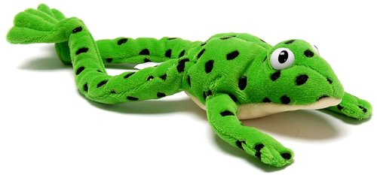
Set 1 - Blending
In Set 1, your child will learn to read words containing set 1 speedy sounds by blending. For example:
m-a-t mat
c-a-t cat
g-o-t got
f-i-sh fish
s-p-o-t spot
b-e-s-t best
s-p-l-a-sh splash
Sounds blending demo
https://www.youtube.com/watch?v=MNyFikwNQTg
We use ‘Fred talk’ to help the children with their blending. Your children will be familiar with this phrase and with the cuddly frog toy.
When the children are instructed to Fred talk, they know that they need to sound out the individual sounds one at a time.
This is Fred the Frog!
The line underneath ‘sh’ indicates a special friend, with the dots indicating a single sound. The children would Fred talk and then blend together: ‘sh / i / p / ship”

Slide 11

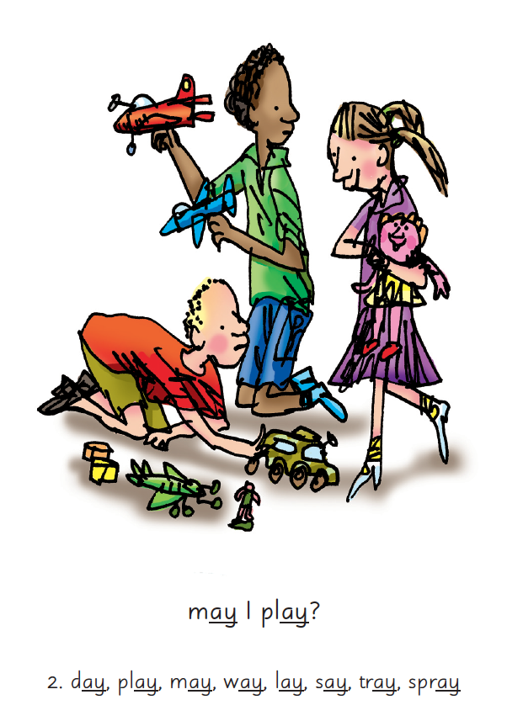
Set 2
Once the children have mastered set 1, the children move onto set 2:
These are the Set 2 Speed Sounds:
ay ee igh ow (as in blow) oo (as in zoo)
oo (as in look) ar or air ir ou (as in out) oy
We teach children sounds using a picture phrases to help them remember.
For example: ‘ay, may I play?’

Slide 12
Set 3
Once the children have mastered set 1 and 2, the children move onto set 3:
These are the Set 3 Speed Sounds:
ea (as in tea)
oi (as in spoil)
a–e (as in cake)
i–e (as in smile)
o–e (as in home)
u–e (as in huge)
aw (as in yawn)
are (as in care)
ur (as in nurse)
er (as in letter)
ow (as in brown)
ai (as in snail)
oa (as in goat)
ew (as in chew)
ire (as in fire)
ear (as in hear)
ure (as in pure)

Slide 13

What can you do at home?
Read with your child at home daily.
I cannot stress enough how important home reading is. Your child will have a book that corresponds with their phonics level –this will be a RWI ink book. Reading this with your child will consolidate your child’s learning and move them forward. Home reading should be a part of your child’s daily routine.
Do not read the book aloud before your child reads it to you.
Ask your child to read the sounds and words before he or she reads the story.
When your child reads the story, ask him or her to sound out
the words that he or she can’t read automatically. Don’t allow your child to struggle too much. Praise your child when he or
she succeeds.
Read back each sentence or page to keep the plot moving. (Your child’s energy is going into reading the words not the story.)
Do not ask your child to guess the word by using the pictures.
Do it all with patience and love!
Tips for when you’re reading with your child.
2. Use ‘special friends’ and ‘friend talk’.
Try your best to use the correct RWI language. It is important that we are constantly consolidating the children’s understanding and knowledge.
3. Engage with the resources that have been provided to you.
You will have been given various resources. By using these with your child, you will be increasing their chances of succeeding in phonics and becoming a strong reader.

Slide 14

We will now be happy to answer any questions that you may have.

